Slide 1
MapChat
Team:
Peiyan Liu, Supreeth Kabbin, Sriya Mahankali
Spencer Ortega, Bailin Chen
Professor: Mike Zyda

Slide 2

Goal
Quest based game
English practice from everyday "chats"
Mimic real-world experience
Notes:
Spencer

Slide 3
Features
Utilized various existing Machine learning services
2D playground 3D real map
Player will be given a list of words
Use the words in the conversations to collect points
Level up when gets enough points
Words will be more complex as level increases
Notes:
Bailin

Slide 4
Game Structure
MapBox
Content Generation
Player
Watson NLU
Watson STT
Score System
(user input evaluation)
Unity
GrammarBot
Notes:
Bailin

Slide 5
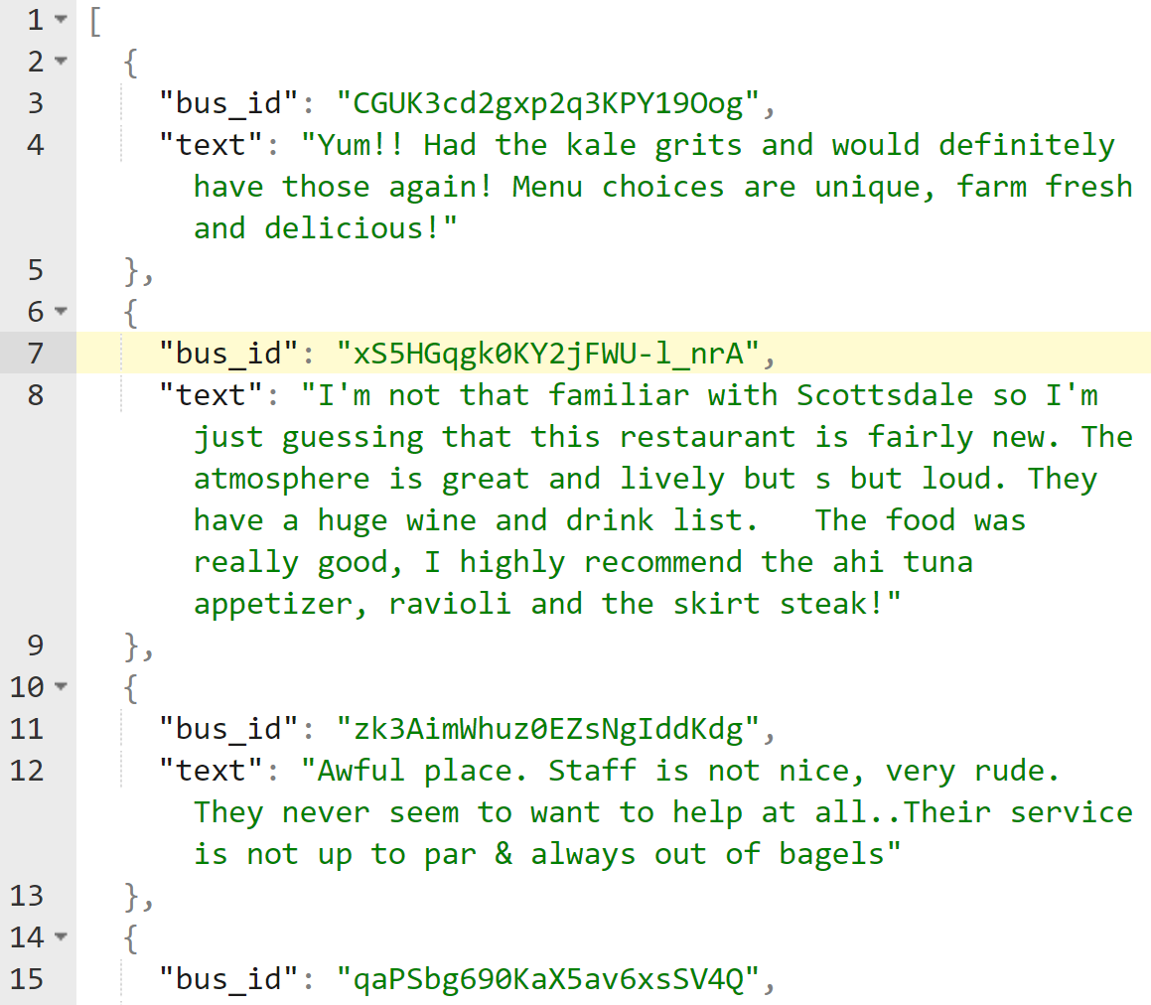
Content Generation
Need content to engage our users
Initially trained RNNs to generate text
Trained on Yelp reviews
Used USC HPC resources
Results were not suitable for gameplay
Used the Yelp data as content instead
Real people talking about real things
Notes:
Spencer

Slide 6
Watson Speech to Text
Default Speech-to-text model not accurate in certain circumstance
Issues pertaining to :
Accent of user
Noisy background
Increase the accuracy by training the model
Using VOiCES open-source dataset
CMU_ARCTIC speech synthesis databases
Notes:
Sriya - updated improvement

Slide 7
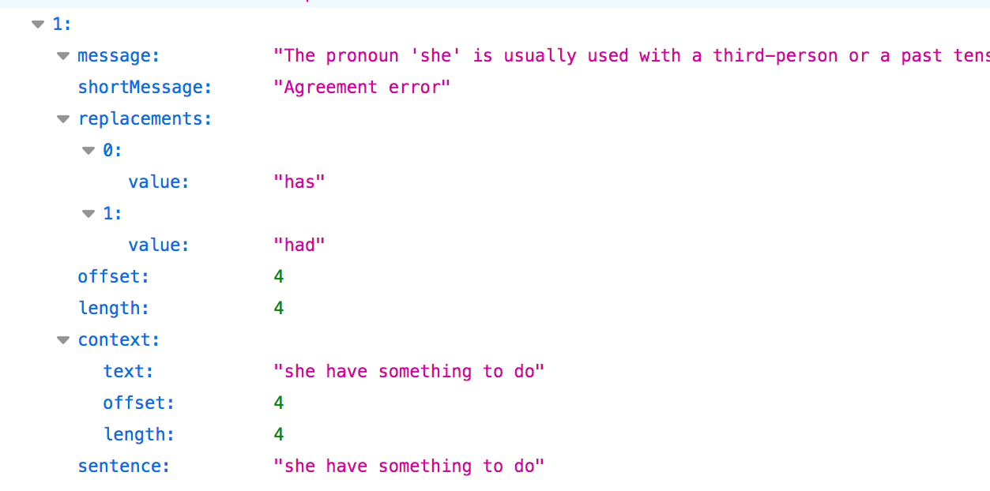
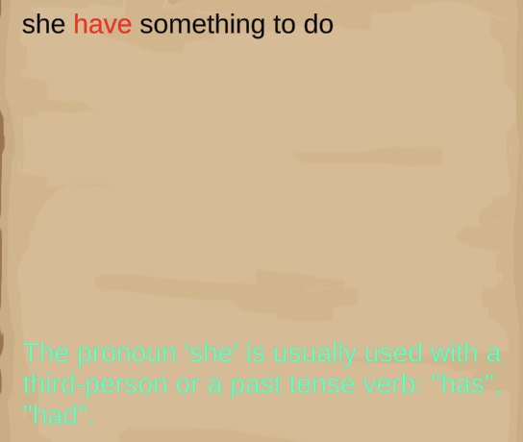
GrammarBot
Checks the grammar mistakes by requesting api.grammar.io
Shows the location and mark the mistakes in
the chatbox
Used to evaluate user’s performance
Notes:
Aaron

Slide 8
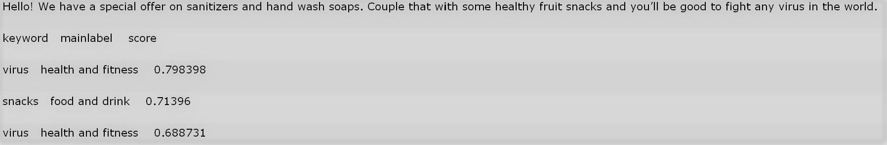
Watson Natural Language Understanding
Extract Contextual Category of sentences
Employ Weighted Average IoU as the measure
Calculate contextual similarity of voice input
Similarity measure used to evaluate user’s performance
KEYWORD | CATEGORY | FITNESS SCORE
virus | Health and Fitness | 0.798398
snacks | Food and Drink | 0.71396
virus | Health and Fitness | 0.688731
Notes:
Supreeth - change the pic

Slide 9
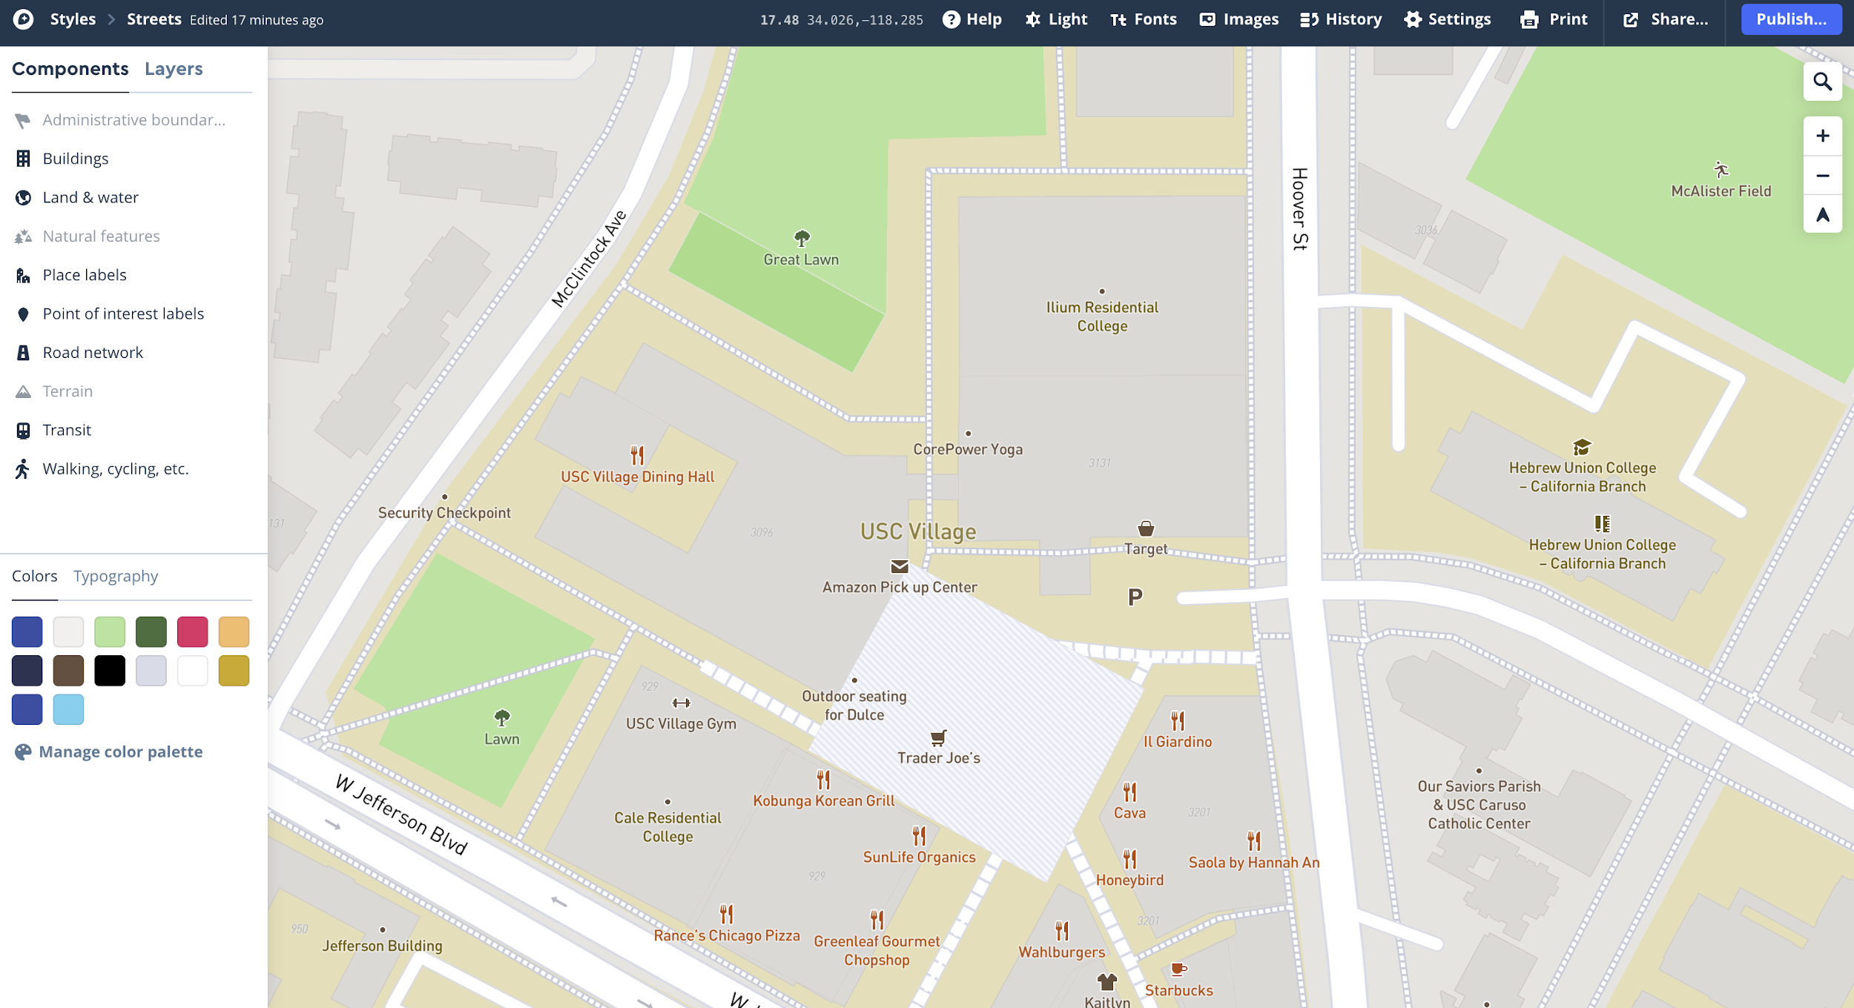
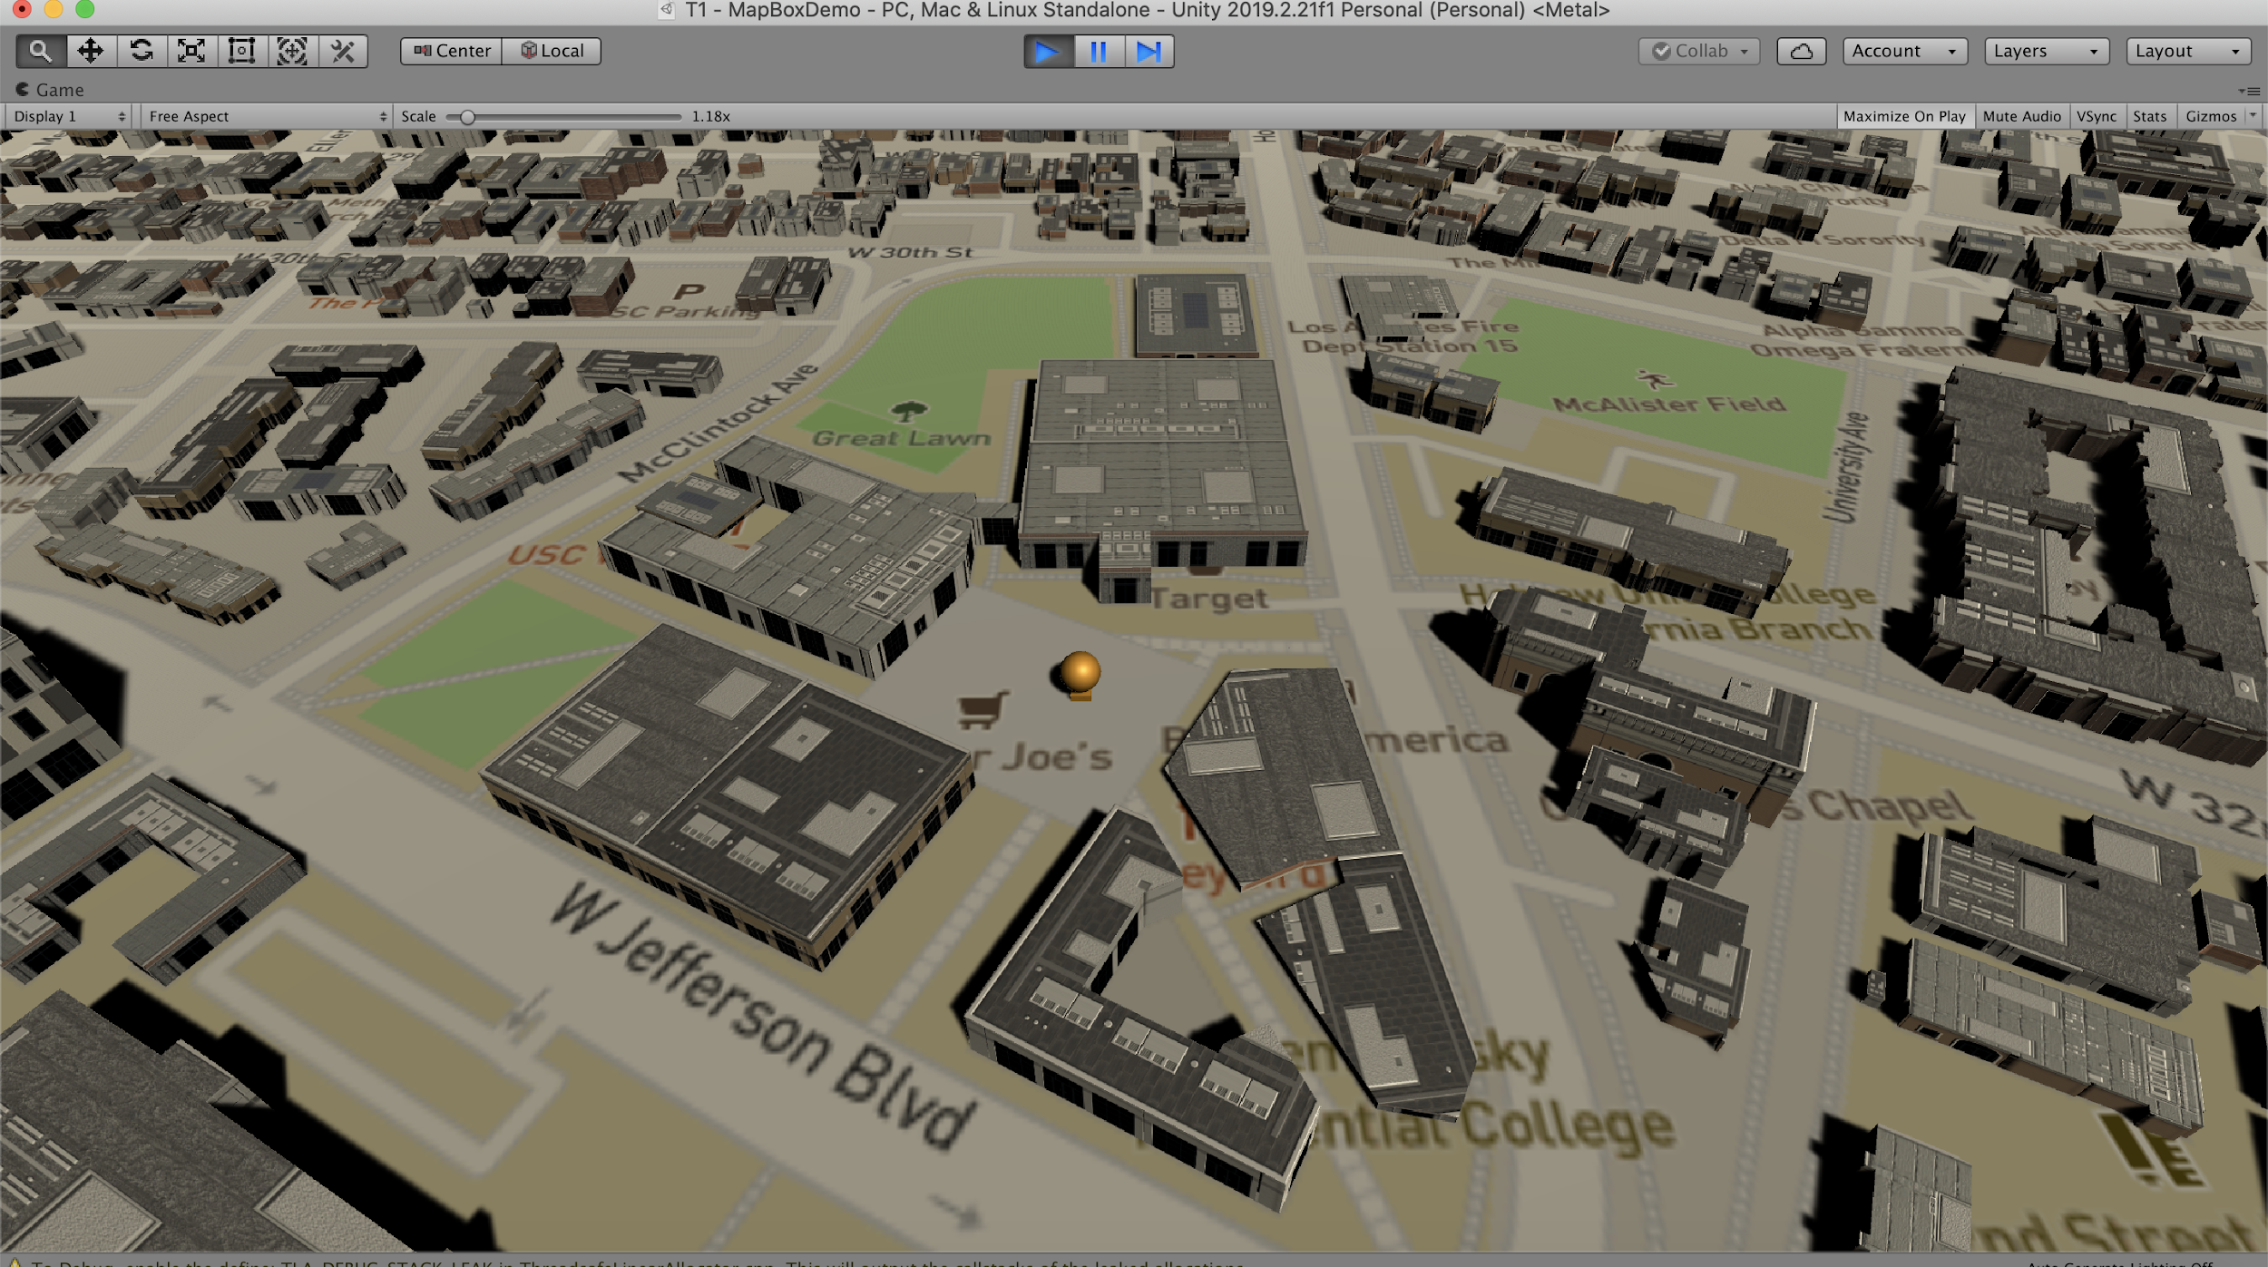
MapBox
Major move towards a real world environment
Focus on USC Village
Players can interact with familiar surroundings
Notes:
Supreeth - gif of moving around/styles

Slide 10
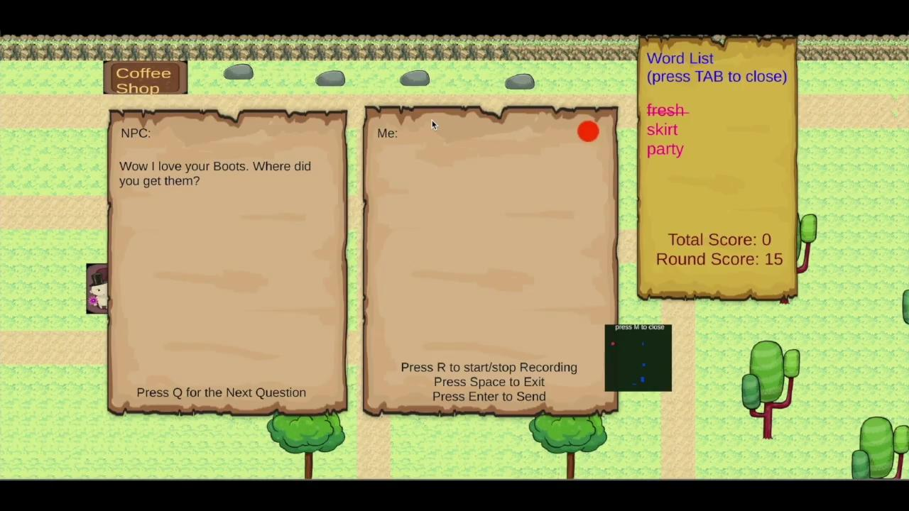
Demo

Slide 11
Future work
Use paid/alternate versions of speech to text and NLU to further train the models
Improve RNN models to generate content in game
Dynamically assign ‘chat spots’ on the 3D map
Refined scoring system
Notes:
Sriya

